Slide 1

#Python Workshop
YOUR LOGO HERE
Let’s code…
INDEX.IPYNB

Slide 2
<WHOA!>
YOUR LOGO HERE
Hey guys this is Pranav, Pranav Sharma. I’m student at Department of Technology and I’m here to share my knowledge of python with you guys… I hope, I won’t be a bore and you’ll enjoy the session…

Slide 3
print(“Contents”)
#01
#CONCEPTS
#02
#NumPy
#03
#Pandas
#04
#Seaborn / Sklearn
YOUR LOGO HERE
Introduction to the language and IDE.
Introduction to NumPy...
Introduction to Pandas...
Intro to ML..

Slide 4

#01
print(“Concepts”)
YOUR LOGO HERE
Introduction to language...

Slide 5
#INTRODUCTION
YOUR LOGO HERE
What you people think ‘bout this language?
Well someone asked me the same when I was introduced to it. And I said “साँप”. Yeah well who keeps a name such like that?
Well they could have kept it Gulab Jamun or Crème Brule or Croc too.
Notes:
In 2019, Python became the second most popular language on GitHub, the largest source code management website on the internet, second only to JavaScript.^{[35]} According to a programming language popularity survey^{[36]} it is consistently among the top 10 most mentioned languages in job postings. Furthermore, Python has been among the 10 most popular programming languages every year since 2004 according to the TIOBE Programming Community Index and got the number one spot on the index in October 2021

Slide 6

#Python
YOUR LOGO HERE
#World Around
Guido van Rossum began working on Python in the late 1980s as a successor to the ABC programming language and first released it in 1991 as Python 0.9.0
#Why Name?
He attributes choosing the name "Python" to "being in a slightly irreverent mood (and a big fan of Monty Python's Flying Circus)"
This Photo by Unknown Author is licensed under CC BY-SA
Notes:
ABC is an imperative general-purpose programming language and integrated development environment (IDE) developed at Centrum Wiskunde & Informatica (CWI), Netherlands by Leo Geurts, Lambert Meertens, and Steven Pemberton.^{[2]} It is interactive, structured, high-level, and intended to be used instead of BASIC, Pascal, or AWK. It is intended for teaching or prototyping, but not as a systems-programming language.
ABC had a major influence on the design of the language Python, developed by Guido van Rossum, who formerly worked for several years on the ABC system in the mid-1980s.

Slide 7

#IDE Well an IDE or Interactive development environment is a platform where programers can code in interactive manner. That means no more black and blue screens. The widely used IDE for python are Visual Studio, Jupyter Notebook, Spyder, Pycharm, Replit and many more…
YOUR LOGO HERE

Slide 8
PIP is a package management system used to install and manage software packages/libraries written in Python. These files are stored in a large “online repository” termed as Python Package Index (PyPI). pip uses PyPI as the default source for packages and their dependencies. So whenever you type: pip install <package_name>, pip will look for that package on PyPI and if found, it will download and install the package on your local system.
YOUR LOGO HERE
pip install python ...

Slide 9



LETS DIVE IN…
YOUR LOGO HERE

Slide 10
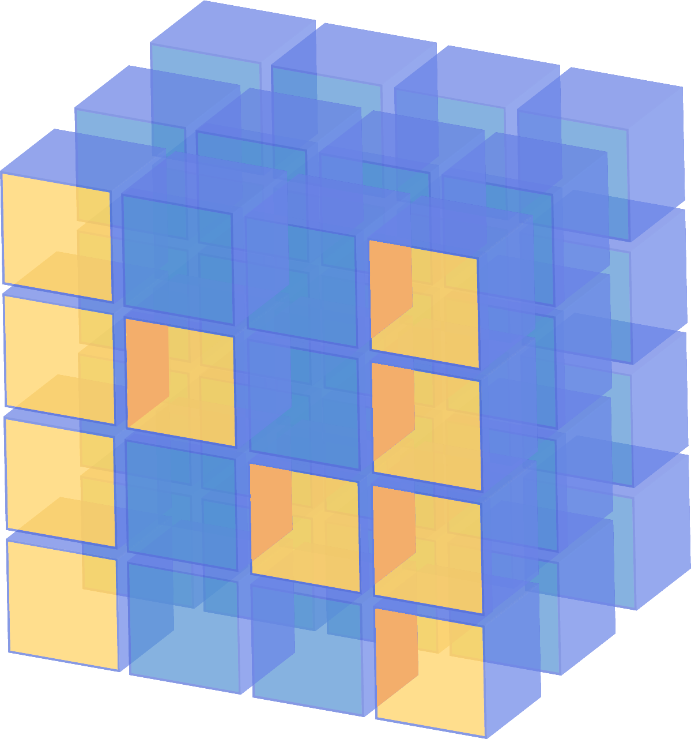
#02
print(“NumPy”)
YOUR LOGO HERE
Introduction to NumPy...

Slide 11
#Array Concept
#install
#NumPy
#Methods
YOUR LOGO HERE
pip install numpy
NumPy is the fundamental package for scientific computing in Python. It is a Python library that provides a multidimensional array object
A method is a set of code which is referred to by name and can be called(invoked)at any point by utilizing the method’s name
#import
import numpy as np
Notes:
A method is a set of code which is referred to by name and can be called (invoked) at any point in a program simply by utilizing the method's name.

Slide 12
#Method…
YOUR LOGO HERE
#creation
#print
>>>arr = np.array([[2,3,4],[5,6,7]])
>>>print(arr)
[[2 3 4]
[5 6 7]]
#type
>>>type(arr)
numpy.ndarray
>>>arr
array([[2, 3, 4], [5, 6, 7]])

Slide 13
#Method…
YOUR LOGO HERE
#datatype
#edited datatype
>>>arr.dtype
dtype('int32')
>>>arr1.dtype
dtype('int8')
#edit datatype
#shape
>>>arr1=np.array([[2,3,4],[5,6,7]],np.int8)
>>>arr1.shape
(2, 3)
Notes:
Data type Object (dtype) in NumPy Python. Every ndarray has an associated data type (dtype) object. This data type object (dtype) informs us about the layout of the array. This means it gives us information about : Type of the data (integer, float, Python object etc.) Size of the data (number of bytes)

Slide 14
#Method…
YOUR LOGO HERE
#size
#acsses elements
>>>arr.size
6
>>>arr[0,2]
4
>>>arr.len
AttributeError: 'numpy.ndarray' object has no attribute 'len'
# arr_name [<rows>,<row>]
# index starts from 0...

Slide 15
#Method…
YOUR LOGO HERE
#numpy with sets
#edited datatype
>>>np.array({1,2,3})
array({1, 2, 3}, dtype=object)
>>>l.dtype
dtype('O')
#array of zeros
#array of ones
>>>z=np.zeros((3,4))
# 3 rows 4 columns
>>>np.ones(5)
array([1., 1., 1., 1., 1.])

Slide 16
#Method…
YOUR LOGO HERE
#print
#print
>>>z
array([[0., 0., 0., 0.],
[0., 0., 0., 0.],
[0., 0., 0., 0.]])
>>>rng
array([0, 1, 2, 3, 4, 5, 6, 7, 8, 9])
#space
#emelents in range
>>>s=np.linspace(1,10,10)
(2, 3)
>>>rng=np.arange(10)
Notes:
Arange:
Parameters
start : integer or real, optional Start of interval. The interval includes this value. The default start value is 0. stop : integer or real End of interval. The interval does not include this value, except in some cases where step is not an integer and floating point round-off affects the length of out. step : integer or real, optional Spacing between values. For any output out, this is the distance between two adjacent values, out[i+1] - out[i]. The default step size is 1. If step is specified as a position argument, start must also be given. dtype : dtype The type of the output array. If dtype is not given, infer the data type from the other input arguments. like : array_like Reference object to allow the creation of arrays which are not NumPy arrays. If an array-like passed in as like supports the __array_function__ protocol, the result will be defined by it. In this case, it ensures the creation of an array object compatible with that passed in via this argument.
Returns
arange : ndarray Array of evenly spaced values.
For floating point arguments, the length of the result is ceil((stop - start)/step). Because of floating point overflow, this rule may result in the last element of out being greater than stop.
arange : Similar to linspace, but uses a step size (instead of the number of samples).
numpy.linspace : Evenly spaced numbers with careful handling of endpoints.
Parameters
start : array_like The starting value of the sequence. stop : array_like The end value of the sequence, unless endpoint is set to False. In that case, the sequence consists of all but the last of num + 1 evenly spaced samples, so that stop is excluded. Note that the step size changes when endpoint is False. num : int, optional Number of samples to generate. Default is 50. Must be non-negative. endpoint : bool, optional If True, stop is the last sample. Otherwise, it is not included. Default is True. retstep : bool, optional If True, return (samples, step), where step is the spacing between samples. dtype : dtype, optional The type of the output array. If dtype is not given, the data type is inferred from start and stop. The inferred dtype will never be an integer; float is chosen even if the arguments would produce an array of integers.
axis : int, optional The axis in the result to store the samples. Relevant only if start or stop are array-like. By default (0), the samples will be along a new axis inserted at the beginning. Use -1 to get an axis at the end.
Returns
samples : ndarray There are num equally spaced samples in the closed interval [start, stop] or the half-open interval [start, stop) (depending on whether endpoint is True or False). step : float, optional Only returned if retstep is True
Size of spacing between samples.

Slide 17
#Method…
YOUR LOGO HERE
#print
#anther one
>>>s
array([ 1., 2., 3., 4., 5., 6., 7., 8., 9., 10.])
>>>s=np.linspace(1,5,10)
#print
>>>s
array([1. , 1.44444444, 1.88888889, 2.33333333, 2.77777778, 3.22222222, 3.66666667, 4.11111111, 4.55555556, 5. ])
#print l
>>>l
array({1, 2, 3}, dtype=object)

Slide 18
#Method…
YOUR LOGO HERE
#another zero/catch
#empty_like
>>>np.empty([2,3])
array([[0., 0., 0.],
[0., 0., 0.]])
>>>s=np.empty_like(emp)
#print
>>>np.empty([2,2])
array([[2.12199579e-314,
1.34534533e-311],
[7.66789882e-321,
3.79442416e-321]])
>>>s
array([[2.12199579e-314,
1.34534533e-311],
[7.66789882e-321,
3.79442416e-321]])
Notes:
empty
Parameters
shape : int or tuple of int Shape of the empty array, e.g., (2, 3) or 2.
Returns
out : ndarray Array of uninitialized (arbitrary) data of the given shape, dtype, and order. Object arrays will be initialized to None.
See Also
empty_like : Return an empty array with shape and type of input. ones : Return a new array setting values to one. zeros : Return a new array setting values to zero. full : Return a new array of given shape filled with value.
empty, unlike zeros, does not set the array values to zero, and may therefore be marginally faster. On the other hand, it requires the user to manually set all the values in the array, and should be used with caution.
Examples
>>> np.empty([2, 2]) array([[ -9.74499359e+001, 6.69583040e-309], [ 2.13182611e-314, 3.06959433e-309]]) #uninitialized
>>> np.empty([2, 2], dtype=int) array([[-1073741821, -1067949133], [ 496041986, 19249760]]) #uninitialized
Empty_like
Parameters
prototype : array_like The shape and data-type of prototype define these same attributes of the returned array. Returns
out : ndarray Array of uninitialized (arbitrary) data with the same shape and type as prototype.

Slide 19
#Method…
YOUR LOGO HERE
#reshape
#sum
>>>arr1.reshape(3,2)
array([[2, 3],
[4, 5],
[6, 7]], dtype=int8)
>>>arr1.sum(axis=0)
array([ 7, 9, 11])
>>>arr1.sum(axis=0)
array([ 9, 18])
>>>arr1.sum(axis=3)
AxisError: axis 3 is out of bounds for array of dimension 2
>>>arr1
array([[2, 3, 4], [5, 6, 7]], dtype=int8)

Slide 20
#Method…
YOUR LOGO HERE
#redefination
#sub
>>>arr1=np.array([[1,2,3],[4,5,6]])
>>>arr2=np.array([[4,5,6],[6,7,8]])
>>>arr1-arr2
array([[-3, -3, -3],
[-2, -2, -2]])
#add
#multiply
>>>arr1+arr2
array([[ 5, 7, 9],
[10, 12, 14]])
>>>arr1*arr2
array([[ 4, 10, 18],
[24, 35, 48]])

Slide 21
#Method…
YOUR LOGO HERE
#square root
#max element
>>>np.sqrt(arr1)
array([[1. , 1.41421356, 1.73205081], [2. , 2.23606798, 2.44948974]])
>>>arr1.max()
6
#min element
#add
>>>arr1.min()
1
>>>arr1+arr2
array([[ 5, 7, 9],
[10, 12, 14]])

Slide 22
#Method (Misc)…
YOUR LOGO HERE
#range and shape
#indexing
>>>np.arange(0, 9).reshape(3,3)
array([[0, 1, 2],
[3, 4, 5],
[6, 7, 8]])
>>>a = np.arange(1,25).reshape(4,-1)
>>>a
array([[1, 2, 3, 4, 5, 6],
[7, 8, 9, 10, 11, 12],
[13, 14, 15, 16, 17,
18],[19, 20, 21, 22,
23, 24]])

Slide 23
#Method (Misc)…
a[1:4,2:]
YOUR LOGO HERE
#indexing
#indexing
>>>a[1:4,2:]
array([[ 9, 10, 11, 12],
[15, 16, 17, 18],
[21, 22, 23, 24]])
>>>a[3,1]
20
>>>a[1:4,3:4]
array([[10], [16], [22]])
>>>a[2:3,2:5]
array([[15, 16, 17]])
#numpy.append
>>>arr3=np.append(arr1,arr2)
array([1, 2, 3, 4, 5, 6, 4, 5, 6, 6, 7, 8])
# array from two arrays
Notes:
>>>arr1=np.array([[1,2,3],[4,5,6]])
>>>arr2=np.array([[4,5,6],[6,7,8]])
a[1:4,3:4]
4 is not considered 4-1 is considered….

Slide 24

#03
print(“Pandas”)
YOUR LOGO HERE
Introduction to Pandas...

Slide 25
#DataFrame concepts…
#install
#pandas
#dataframe
YOUR LOGO HERE
pip install pandas
pandas is a fast, powerful, flexible and easy to use open source data analysis and manipulation tool, built on top of the Python
programming language.
A Data Frame is a data structure that organizes data into a 2-dimensional table of rows and columns, much like a spreadsheet
#import
import pandas as pd

Slide 26
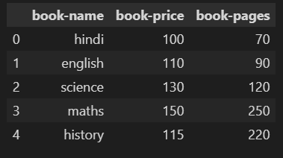
#Method…
YOUR LOGO HERE
#dictionary
#create dataframe
>>>d={
"book-name":
["Hindi","English",“Science",”Moths", “History"],
"book-price":
[100,110,130,150,115],"book-pages“:
[70,90,120,250,220]
}
>>>df=pd.DataFrame(d)
>>>df

Slide 27
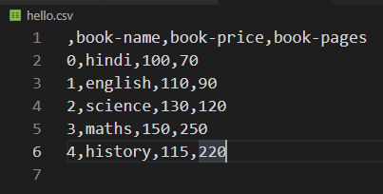
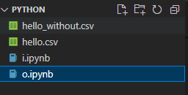
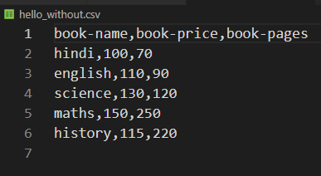
#Method…
YOUR LOGO HERE
#dataframe to csv
>>>df.to_csv('hello.csv’)
>>>df.to_csv('hello_without.csv',index=False)

Slide 28
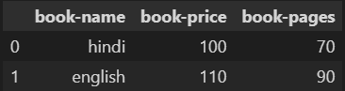
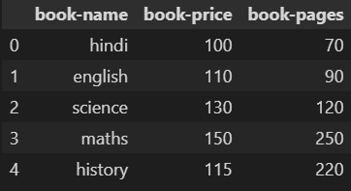
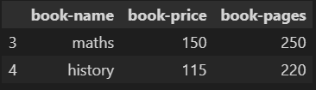
#Method…
YOUR LOGO HERE
>>>df.head(2)
#head
>>>df.head()
>>>df.tail(2)

Slide 29
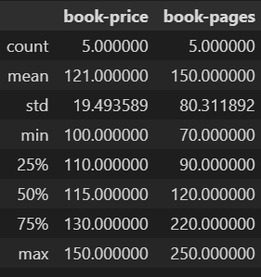
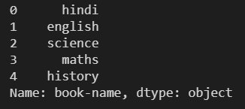
#Method…
YOUR LOGO HERE
#stats
>>>df.describe()
#value
>>>df['book-name']

Slide 30
#Method…
YOUR LOGO HERE
#index
>>>df.index
RangeIndex(start=0, stop=5, step=1)
>>>df.index=['I','II','III','IV','V’]
>>>df.index
Index(['I', 'II', 'III', 'IV', 'V'], dtype='object')
#index
>>>df.columns
Index(['book-name', 'book-price', 'book-pages'], dtype='object')

Slide 31
#Method…
YOUR LOGO HERE
#dataframe to NumPy
#dataframe to NumPy
>>>df.to_numpy()
array([[‘Hindi', 100, 70], [‘English', 110, 90], [‘Science', 130, 120], [‘Math', 150, 250], ['history', 115, 220]], dtype=object)
>>>dataset.shape
(150, 6)

Slide 32
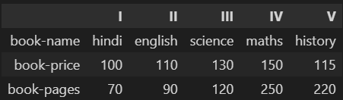
#transpose dataframe >>> df.T

Slide 33
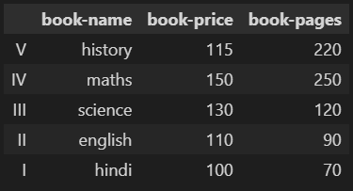
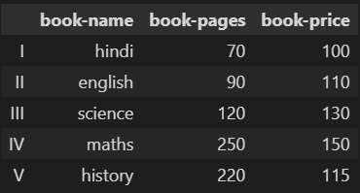
#Method…
YOUR LOGO HERE
#sort
>>>df.sort_index(axis=0, ascending=False)
>>>df.sort_index(axis=0, ascending=True)

Slide 34
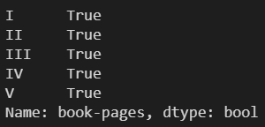
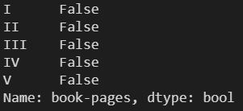
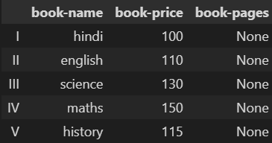
#Method…
YOUR LOGO HERE
#null values
>>>df['book-pages'].isnull()
>>>df['book-pages']=None
>>>df['book-pages'].isnull()
>>>df

Slide 35
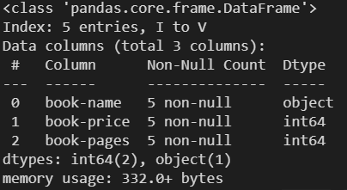
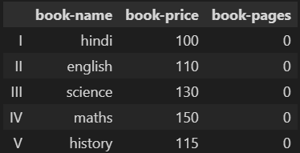
#Method…
YOUR LOGO HERE
#fillna
#info
>>>df.fillna(0, inplace=True)
>>>df.info()
>>>df

Slide 36
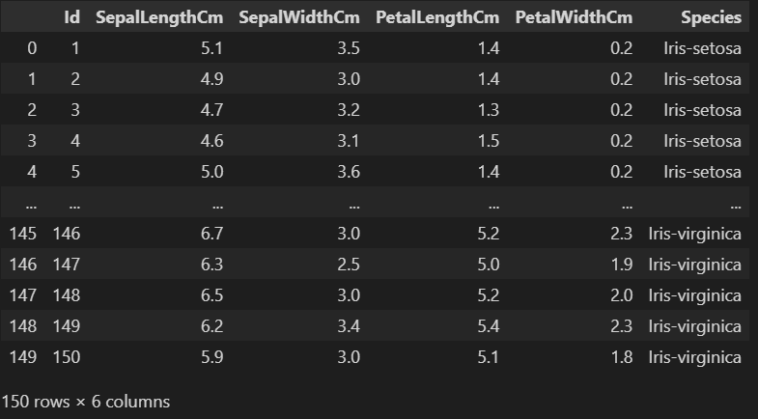
#read csv >>>f=pd.read_csv('iris.csv’) >>>f

Slide 37
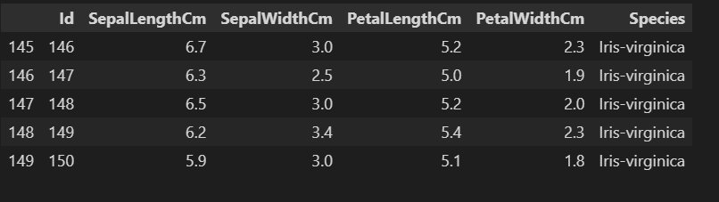
#tail >>>f.tail()

Slide 38
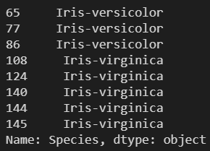
#Method…
YOUR LOGO HERE
#value
>>>f['Species'][123]
'Iris-virginica’
>>>f[f['SepalLengthCm'] == 6.7]['Species']

Slide 39
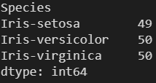
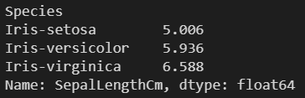
#Method…
YOUR LOGO HERE
#groupby
>>>f.groupby('Species')['SepalLengthCm'].mean()
>>>f.groupby('Species').size()

Slide 40

#04
print(“Seaborn/ Sklearn”)
YOUR LOGO HERE
Introduction to ML...

Slide 41
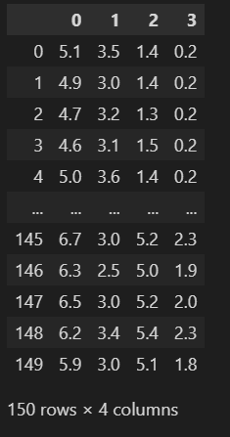
#Method…
YOUR LOGO HERE
#install library( ML )
>>>pip install sklearn
#load data set ( ML )
>>>from sklearn import datasets
>>>iris = datasets.load_iris()
>>>X = pd.DataFrame(iris.data)

Slide 42
#Method…
YOUR LOGO HERE
#split data ( ML )
>>> from sklearn.model_selection import train_test_split
>>> X_train
>>> X_validation
>>> Y_train
>>> Y_validation
>>>array = f.values
>>>X = array[:,0:4]
>>>Y = array[:,4]
>>>validation_size = 0.20
>>>seed = 7
>>>X_train, X_validation, Y_train, Y_validation = model_selection.train_test_split(X, Y, test_size=validation_size, random_state=seed)

Slide 43
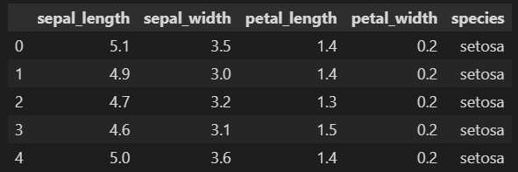
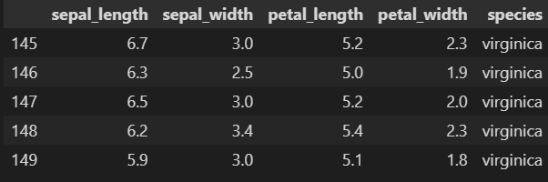
#Method…
YOUR LOGO HERE
#install library( ML )
>>>pip install seaborn
#load data set ( ML )
>>>import seaborn as sns
>>>my_data=sns.load_dataset("iris")
>>>my_data.head()
>>>my_data.tail()

Slide 44
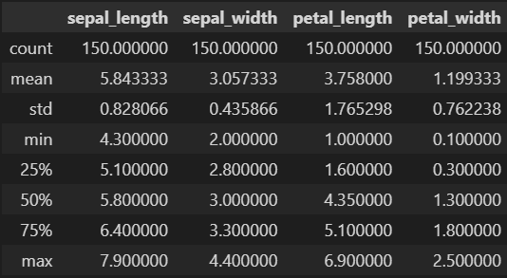
#Method…
YOUR LOGO HERE
#describe
#major plots:
>>>my_data.describe()
>>>pip install matplotlib
>>>import matplotlib.pyplot as plt
>>>%matplotlib inline
# python library to integrate graphs and represent data in graphical manner…

Slide 45
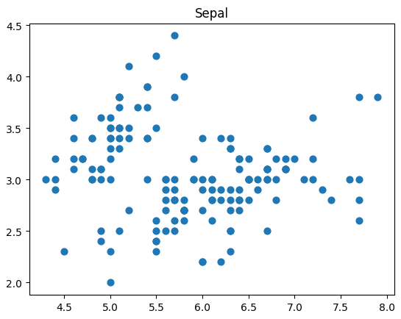
#Method…
YOUR LOGO HERE
#scatterplot
>>>plt.scatter(my_data.sepal_length,my_data.sepal_width,s=40)
>>>plt.title('Sepal’)
# A scatter plot (also called a scatterplot, scatter graph, scatter chart, scattergram, or scatter diagram) is a type of plot or mathematical diagram using Cartesian coordinates to display values for typically two variables for a set of data.
Notes:
1. ABC is an imperative general-purpose programming language and integrated development environment (IDE) developed at Centrum Wiskunde & Informatica (CWI), Netherlands by Leo Geurts, Lambert Meertens, and Steven Pemberton.^{[2]} It is interactive, structured, high-level, and intended to be used instead of BASIC, Pascal, or AWK. It is intended for teaching or prototyping, but not as a systems-programming language.
ABC had a major influence on the design of the language Python, developed by Guido van Rossum, who formerly worked for several years on the ABC system in the mid-1980s.

Slide 46
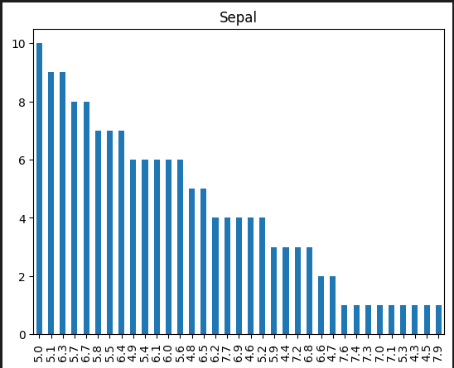
#Method…
YOUR LOGO HERE
#barplot
>>>my_data['sepal_length'].value_counts().plot.bar()
>>>plt.title('Sepal’)
# Bar graphs are the pictorial representation of data (generally grouped), in the form of vertical or horizontal rectangular bars, where the length of bars are proportional to the measure of data
Notes:
1. ABC is an imperative general-purpose programming language and integrated development environment (IDE) developed at Centrum Wiskunde & Informatica (CWI), Netherlands by Leo Geurts, Lambert Meertens, and Steven Pemberton.^{[2]} It is interactive, structured, high-level, and intended to be used instead of BASIC, Pascal, or AWK. It is intended for teaching or prototyping, but not as a systems-programming language.
ABC had a major influence on the design of the language Python, developed by Guido van Rossum, who formerly worked for several years on the ABC system in the mid-1980s.

Slide 47
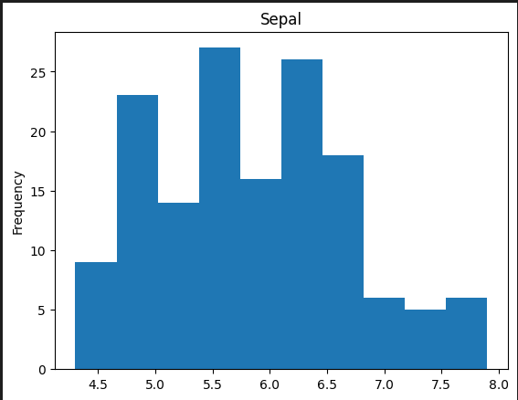
#Method…
YOUR LOGO HERE
#hisotgram
>>>my_data['sepal_length'].plot.hist()
>>>plt.title('Sepal’)
# A histogram is an approximate representation of the distribution of numerical data. A histogram is a graphical representation of a grouped frequency distribution with continuous classes.
Notes:
1. ABC is an imperative general-purpose programming language and integrated development environment (IDE) developed at Centrum Wiskunde & Informatica (CWI), Netherlands by Leo Geurts, Lambert Meertens, and Steven Pemberton.^{[2]} It is interactive, structured, high-level, and intended to be used instead of BASIC, Pascal, or AWK. It is intended for teaching or prototyping, but not as a systems-programming language.
ABC had a major influence on the design of the language Python, developed by Guido van Rossum, who formerly worked for several years on the ABC system in the mid-1980s.

Slide 48
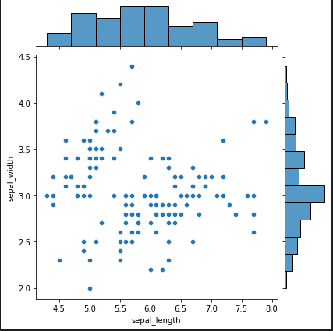
#Method…
YOUR LOGO HERE
#jointplot
>>>sns.jointplot(x="sepal_length",y="sepal_width",data=my_data)
# A Jointplot comprises three plots. Out of the three, one plot displays a bivariate graph which shows how the dependent variable (Y) varies with the independent variable (X). Another plot is placed horizontally at the top of the bivariate graph and it shows the distribution of the independent variable (X).
Notes:
1. ABC is an imperative general-purpose programming language and integrated development environment (IDE) developed at Centrum Wiskunde & Informatica (CWI), Netherlands by Leo Geurts, Lambert Meertens, and Steven Pemberton.^{[2]} It is interactive, structured, high-level, and intended to be used instead of BASIC, Pascal, or AWK. It is intended for teaching or prototyping, but not as a systems-programming language.
ABC had a major influence on the design of the language Python, developed by Guido van Rossum, who formerly worked for several years on the ABC system in the mid-1980s.

Slide 49
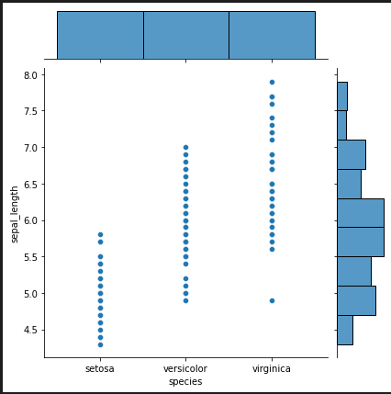
#Method…
YOUR LOGO HERE
#jointplot
>>>sns.jointplot(x="species",y="sepal_length",data=my_data)
Notes:
1. ABC is an imperative general-purpose programming language and integrated development environment (IDE) developed at Centrum Wiskunde & Informatica (CWI), Netherlands by Leo Geurts, Lambert Meertens, and Steven Pemberton.^{[2]} It is interactive, structured, high-level, and intended to be used instead of BASIC, Pascal, or AWK. It is intended for teaching or prototyping, but not as a systems-programming language.
ABC had a major influence on the design of the language Python, developed by Guido van Rossum, who formerly worked for several years on the ABC system in the mid-1980s.

Slide 50
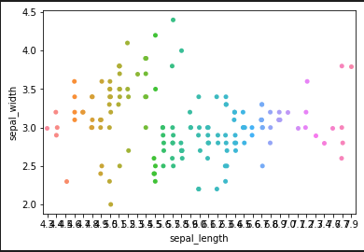
#Method…
YOUR LOGO HERE
#stripplot
>>>sns.stripplot(x="sepal_length",y="sepal_width",data=my_data)
# Strip Plot Also called: Individual Value Plot or Single-Axis Scatter Plot A strip plot is a single-axis scatter plot that is used to visualize the distribution of many individual one-dimensional values
Notes:
1. ABC is an imperative general-purpose programming language and integrated development environment (IDE) developed at Centrum Wiskunde & Informatica (CWI), Netherlands by Leo Geurts, Lambert Meertens, and Steven Pemberton.^{[2]} It is interactive, structured, high-level, and intended to be used instead of BASIC, Pascal, or AWK. It is intended for teaching or prototyping, but not as a systems-programming language.
ABC had a major influence on the design of the language Python, developed by Guido van Rossum, who formerly worked for several years on the ABC system in the mid-1980s.

Slide 51
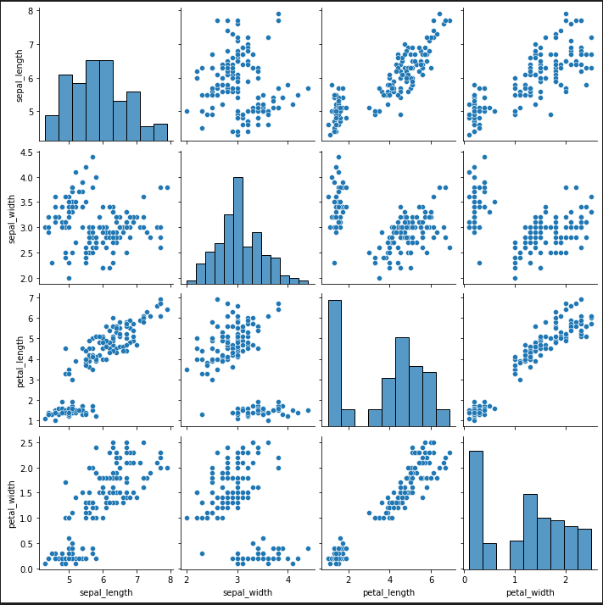
#Method…
YOUR LOGO HERE
#pairplot
>>>sns.pairplot(my_data)
# A pair plot is plotting “pairwise relationships in a dataset” (seaborn.pairplot). A few well-known visualization modules for Python are widely used by data scientists and analysts: Matplotlib and Seaborn.
Notes:
1. ABC is an imperative general-purpose programming language and integrated development environment (IDE) developed at Centrum Wiskunde & Informatica (CWI), Netherlands by Leo Geurts, Lambert Meertens, and Steven Pemberton.^{[2]} It is interactive, structured, high-level, and intended to be used instead of BASIC, Pascal, or AWK. It is intended for teaching or prototyping, but not as a systems-programming language.
ABC had a major influence on the design of the language Python, developed by Guido van Rossum, who formerly worked for several years on the ABC system in the mid-1980s.

Slide 52
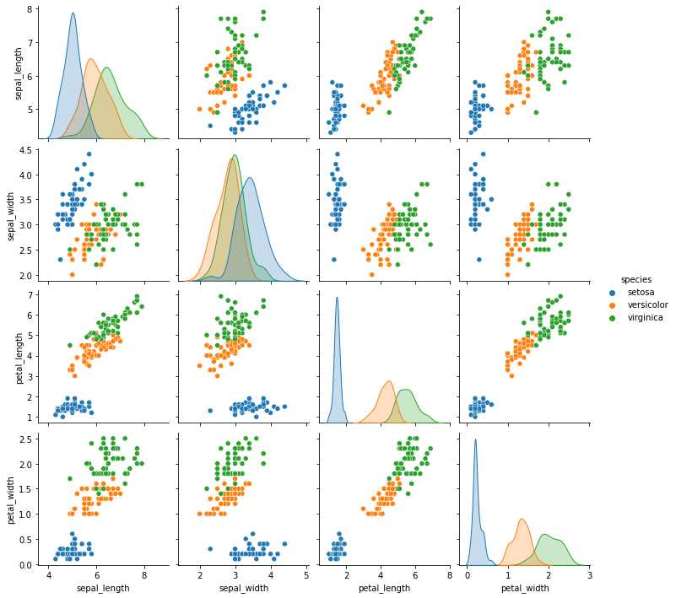
#Method…
YOUR LOGO HERE
#pairplot
>>>sns.pairplot(my_data,hue="species")
Notes:
1. ABC is an imperative general-purpose programming language and integrated development environment (IDE) developed at Centrum Wiskunde & Informatica (CWI), Netherlands by Leo Geurts, Lambert Meertens, and Steven Pemberton.^{[2]} It is interactive, structured, high-level, and intended to be used instead of BASIC, Pascal, or AWK. It is intended for teaching or prototyping, but not as a systems-programming language.
ABC had a major influence on the design of the language Python, developed by Guido van Rossum, who formerly worked for several years on the ABC system in the mid-1980s.

Slide 53

#Method…
YOUR LOGO HERE
#pairplot
>>>sns.pairplot(my_data , hue = "species",markers=["o", "s", "D"])
Notes:
1. ABC is an imperative general-purpose programming language and integrated development environment (IDE) developed at Centrum Wiskunde & Informatica (CWI), Netherlands by Leo Geurts, Lambert Meertens, and Steven Pemberton.^{[2]} It is interactive, structured, high-level, and intended to be used instead of BASIC, Pascal, or AWK. It is intended for teaching or prototyping, but not as a systems-programming language.
ABC had a major influence on the design of the language Python, developed by Guido van Rossum, who formerly worked for several years on the ABC system in the mid-1980s.

Slide 54
# A1
APENDIX
YOUR LOGO HERE
Upload your work on Github...

Slide 55


Find content on Github… Scan the under laying QR code to navigate there…
print(“Thanks”)
Adios…

